Slide 1


Android Layout
+
Bayu Firmawan Paoh
Codelabs Unikom

Slide 2

Android Layout
Linear Layout
Relative Layout
Absolute Layout
Frame Layout
Intent ( Extras)

Slide 3
Linear Layout
A layout that organizes its children into a single horizontal
or vertical row.

Slide 4

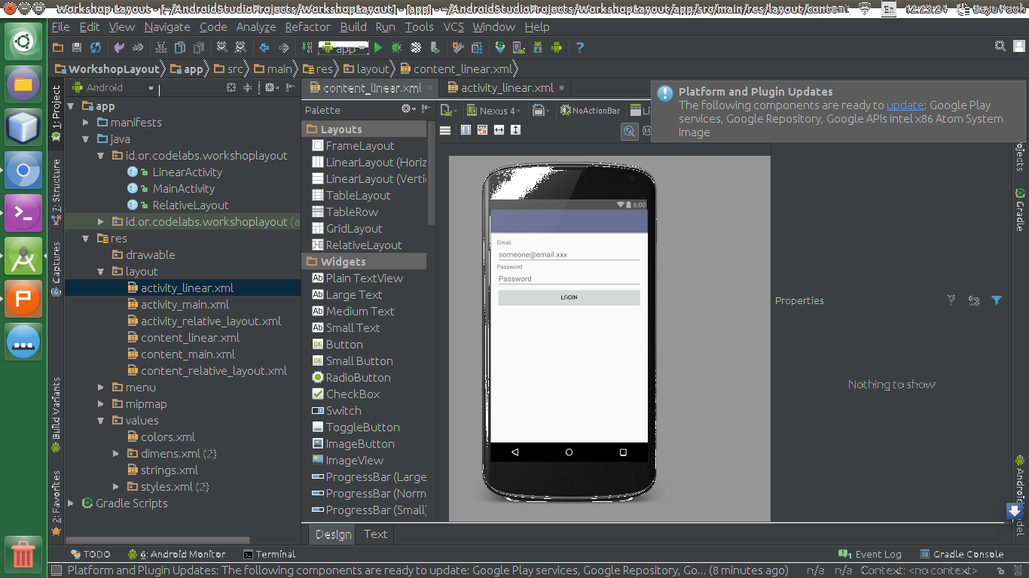
Linear Layout
<LinearLayout
xmlns:android="http://schemas.android.com/apk/res/android"
android:layout_width="fill_parent"
android:layout_height="fill_parent"
android:orientation="horizontal | vertical">
<!-- widget2 disini-->
</LinearLayout>

Slide 5
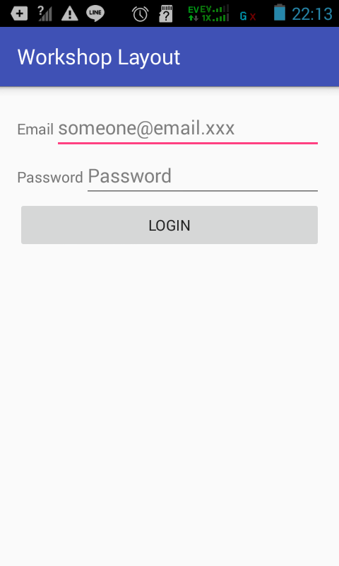
How ???

Slide 6
Hint
android:orientation="horizontal"

Slide 7
Relative Layout
Enables you to specify the location of child objects relative to each other (child A to the left of child B) or to the parent (aligned to the top of the parent).

Slide 8
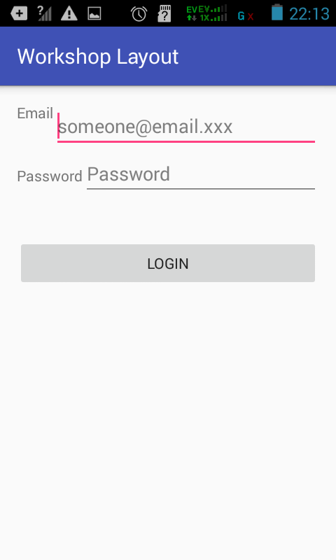
Relative Layout
<RelativeLayout
xmlns:android="http://schemas.android.com/apk/res/android"
android:layout_width="fill_parent"
android:layout_height="fill_parent">
<!-- widget2 disini-->
</RelativeLayout>

Slide 9
Absolute Layout
A layout that lets you specify exact locations (x/y coordinates) of its children.

Slide 10
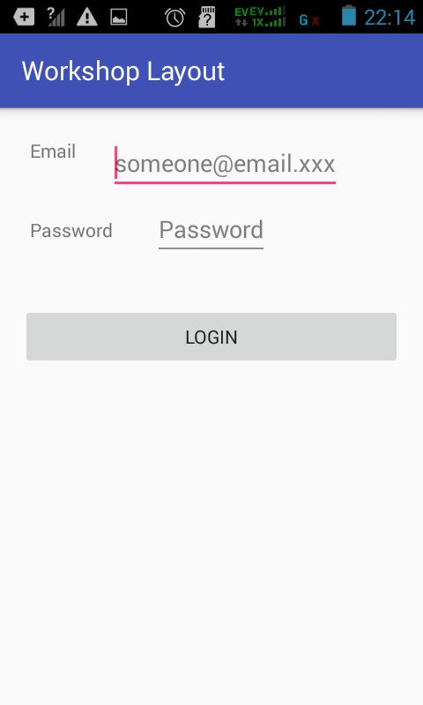
Absolute Layout
<AbsoluteLayout
xmlns:android="http://schemas.android.com/apk/res/android"
android:layout_width="fill_parent"
android:layout_height="fill_parent">
<!-- widget2 disini-->
</AbsoluteLayout>

Slide 11
Frame Layout
FrameLayout is designed to block out an area on the screen to display a single item.

Slide 12

Frame Layout
<FrameLayout
xmlns:android="http://schemas.android.com/apk/res/android"
android:layout_width="fill_parent"
android:layout_height="fill_parent">
<!-- widget2 disini-->
</FrameLayout>

Slide 13
Intent
An Intent provides a facility for performing late runtime binding between the code in different applications.

Slide 14
Intent
Intent intent = new Intent(this, ActivityName.class);
startActivity(intent);

Slide 15
Challenges

Slide 16




Slide 17

STAY HUNGRY
STAY FOOLISH
+
Slide : goo.gl/VpZgd1
Project : github.com/bayupaohganteng/androidlayout.git
References : developer.android.com

